Slide 1
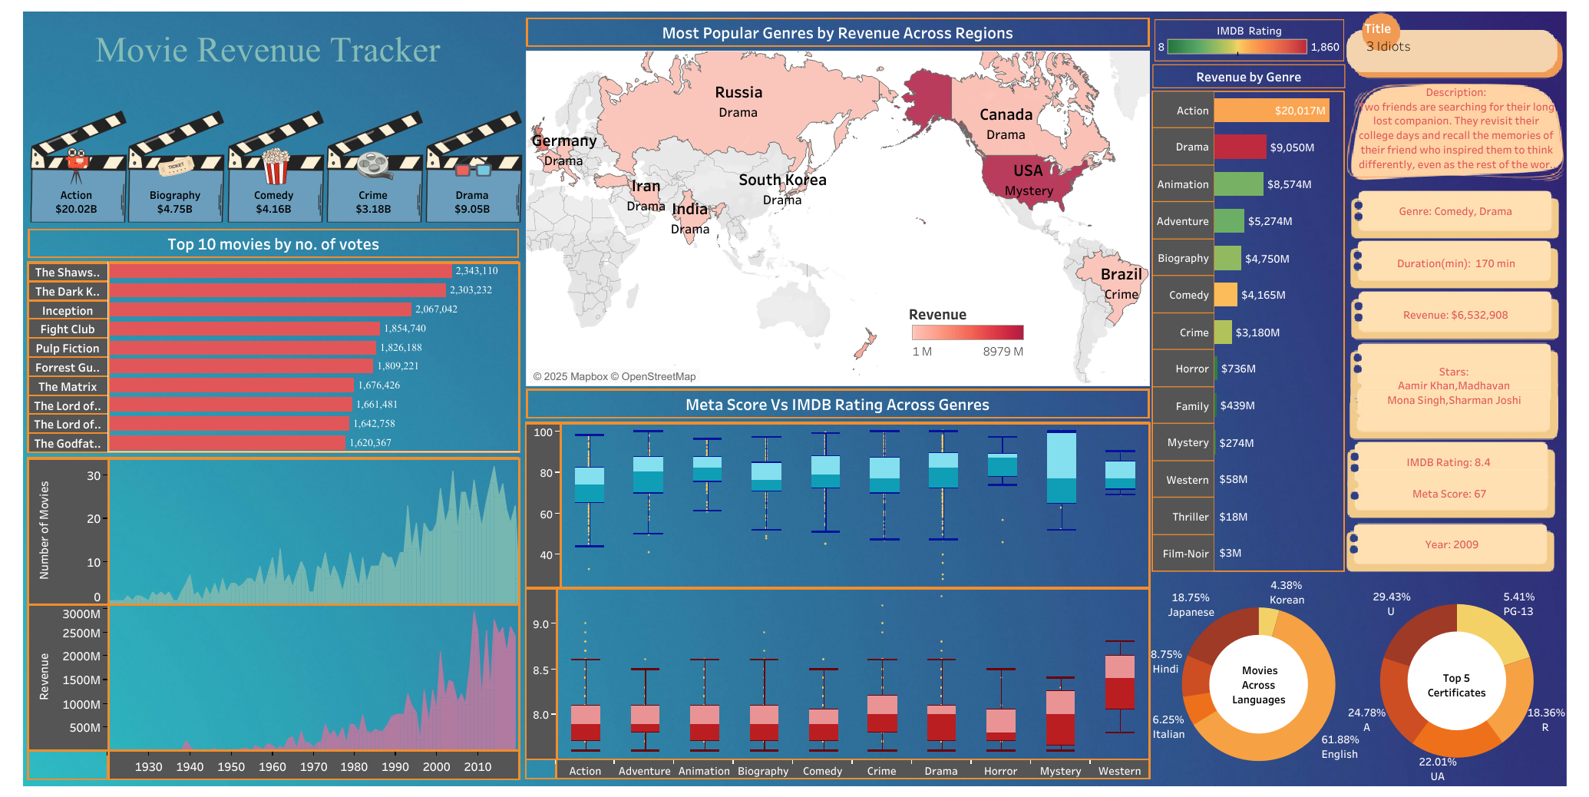
Movie Revenue Tracker – Data Analytics Dashboard
IMDB Top 1000 Movies Analysis
Presented by: Soumyaditya Saha
Email: soumyaditya_2312res654@iitp.ac.in
Tool Used: Tableau
Date: 02/08/2025

Slide 2
Dashboard

Slide 3
Project Overview: Unlocking Box Office Insights
This project, the "Movie Revenue Tracker," addresses a critical question for film studios: how do box office collections compare across different movies and global regions? This is to empower studios with data-driven insights to optimize their release strategies.
Project Title
Core Question
Core Question
Movie Revenue Tracker
Comparing box office performance across regions and genres.
Comparing box office performance across regions and genres.

Slide 4



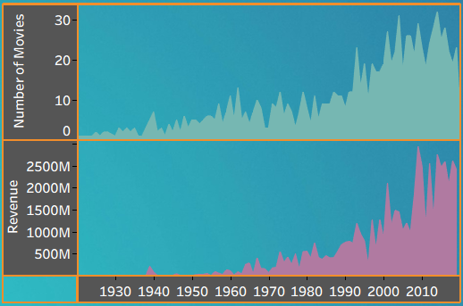
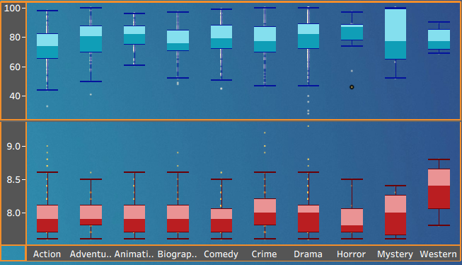
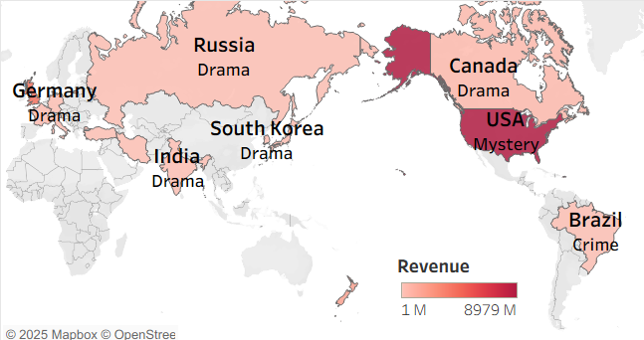
Dashboard Overview: Navigating Cinematic Data
Our interactive dashboard provides a comprehensive view of movie performance, designed to reveal critical trends and viewer preferences.
Performance Insights
Trend Analysis
Global Preferences
Analyze movie performance by region, genre, and release year to identify key markets.
Track revenue and rating trends over time to forecast future successes.
Understand viewer preferences across different geographic regions and cultural contexts.

Slide 5


Methodology: From Data to Dashboard
This analysis involved acquiring an IMDB dataset from Kaggle, followed by data cleaning and the creation of calculated fields (e.g., regions by director, genre grouping). We then visualized key insights through interactive charts and dashboards using Tableau to transform raw data into actionable movie performance insights.
1
Data Import
IMDB Top 1000 dataset imported for analysis.
2
Data Cleaning
Structured key fields: Genre, Region, Release Year, Revenue, IMDB Rating.
3
Calculated Field Creation
Used existing data to derive new insights (e.g., region by director, language grouping, primary genre).
4
Visualization Creation
Grouped data by Region, Genre, Year; aggregated Revenue and Ratings.
5
Interactivity
Implemented dynamic filters and slicers for an engaging user experience.

Slide 6
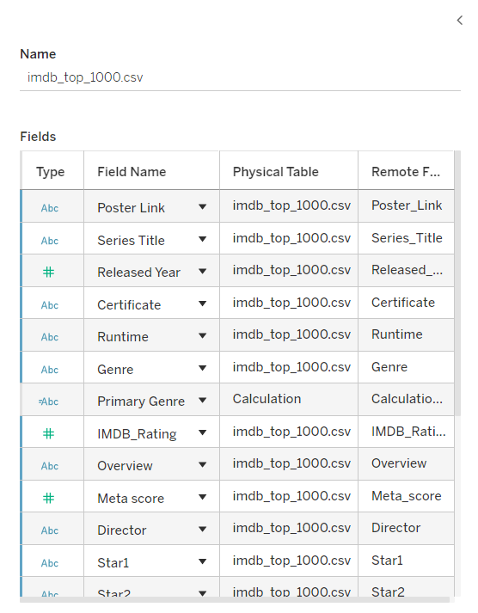
Data Foundation: Import & Cleaning in Tableau
The foundation of our analysis began by connecting the raw CSV dataset to Tableau. We then meticulously cleaned and refined the data, ensuring accuracy and consistency across all key dimensions.
CSV dataset directly connected to Tableau.
Genre values cleaned and standardized.
Region assigned based on director's origin for better geographical mapping.
Certificate, runtime, and revenue fields precisely mapped and formatted.

Slide 7
Key Visualizations: A Comprehensive View
This dashboard brings together a wide variety of visualizations—including maps, bar and donut charts, and box plots—to provide a holistic analysis of movie performance and audience engagement. Each chart is thoughtfully chosen to reveal unique insights: from tracking revenue growth and genre popularity to comparing audience and critic scores, and understanding language and certification trends. This comprehensive approach ensures that every key aspect of the movie industry is clearly highlighted and easy to interpret.

Slide 8
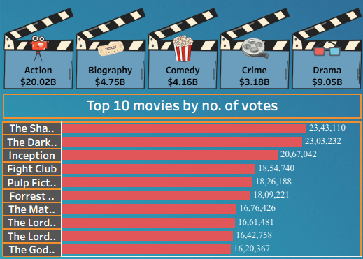
Top Genres by Revenue & Audience Engagement
Description & Trend Analysis:
The upper section of the chart visually highlights genre-wise revenue, where:
Action dominates with the highest global revenue of $20.02B, showcasing its mass appeal and high production value.
Drama follows at $9.05B, reflecting its broad narrative scope and emotional depth, resonating globally.
The lower section shows the Top 10 Movies by Number of Votes:
Movies like The Shawshank Redemption and The Dark Knight lead with over 23 million votes, suggesting strong, lasting audience engagement and popularity.
These films span multiple genres, but Drama, Action, and Crime appear most frequently—confirming genre popularity aligns with both revenue and viewer interest.
Key Insights:
Genres with high box office performance also tend to feature heavily in fan-voted rankings, indicating that commercial and critical success often align.
This blend of financial and audience data provides a well-rounded view of genre impact in the global movie market.

Slide 9
World Map: Popular Genres by Region
The map visualizes which movie genre generates the most revenue in each highlighted country.
Drama dominates as the top-earning genre in Germany, Russia, South Korea, India, and Canada, suggesting a global preference for dramatic storytelling.
Mystery is most popular in the USA, indicating strong audience interest in suspense and thrillers there.
Crime stands out in Brazil, reflecting regional tastes for crime dramas.
The color intensity represents total revenue, with the USA and Canada leading in overall box office collections.
This regional breakdown helps studios tailor genre releases for maximum impact in specific markets.

Slide 10
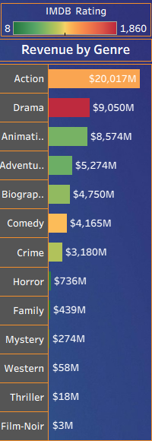
Revenue & Ratings Across Genres
Action is the highest-grossing genre, generating $20,037M in revenue, far surpassing all others.
Drama ranks second with $9,050M, indicating strong audience interest in dramatic stories.
Other notable genres by revenue include Animation ($8,574M), Adventure ($5,274M), and Biography ($4,750M).
Genres such as Mystery, Western, Thriller, and Film-Noir contribute significantly less revenue, each earning under $300M.
The clear revenue gap highlights industry reliance on a few blockbuster genres, while niche genres attract smaller, specialized audiences.
The accompanying IMDB Rating bar adds insight into how audience ratings compare across these genres, supporting informed production and marketing decisions.

Slide 11
Timeline: Movie Releases & Revenue
The timeline charts display both the number of movies released and total box office revenue from the 1930s to 2010.
There is a steady growth in both metrics over the decades, with particularly notable increases after the 1970s.
The number of movies released per year rises sharply from the 1980s onward, indicating industry expansion and greater film output.
Revenue shows a significant surge, especially in recent decades—demonstrating not only more movies but also higher earnings per film.
This trend highlights the growing popularity and commercial success of the film industry over time, driven by increased production, larger audiences, and possibly global market expansion.

Slide 12
IMDB vs. Meta Score Box Plot
The chart compares IMDB audience ratings (bottom plot) with critic Meta Scores (top plot) across various genres.
Animation and Western genres show higher median Meta Scores, indicating strong critical acclaim.
Most genres, including Action, Adventure, and Drama, receive consistently strong IMDB ratings—typically clustered between 8.0–8.5.
Comedy and Horror show a wider spread in both ratings and Meta Scores, reflecting broader variation in audience and critic responses.
The side-by-side analysis reveals genres where critics and audiences align or differ, providing valuable insight for studios on genre performance with both groups.

Slide 13
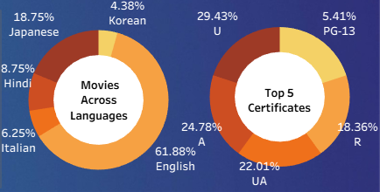
Language & Certification Donut Charts
English dominates with 61.88% of total movies, making it the most common language for film releases. Other notable languages include Japanese (18.75%), Hindi (8.75%), Italian (6.25%), and Korean (4.38%).
For certifications, the top category is "U" (29.43%), followed by "A" (24.78%), "UA" (22.01%), "R" (18.36%), and "PG-13" (5.41%).
This distribution highlights a significant preference for English-language films and shows that most movies are rated for general (U, UA) or adult (A, R) audiences.
The charts provide a quick overview of language diversity and audience certification trends in the movie industry.

Slide 14
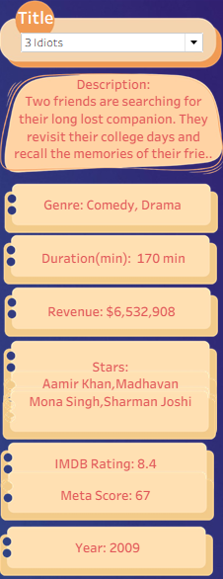
Enhancing User Experience with Interactive Filters
To empower users with granular control over their data exploration, we've integrated powerful interactivity features:
Dynamic Slicers: New slicers for Genre, Language, and Region enable instant filtering of movie data.
Drill-down Capability: Clicking any movie bar in the visualizations now reveals a detailed information card, providing comprehensive insights at a glance.

Slide 15
Key Performance Indicators for Movie Industry Analysis
The Tableau dashboard utilizes a comprehensive set of KPIs to provide deep insights into movie industry performance, enabling data-driven decisions.
🎥 Movie Performance Metrics
Revenue by Genre: Total revenue generated by each genre.
Top 10 Movies by Votes: Audience engagement based on IMDb votes.
Revenue Trend Over Time: Year-wise revenue breakdown (1930s to 2010s).
🌍 Geographic & Regional Insights
Popular Genres by Region: Mapping region-specific genre dominance.
Revenue Heatmap by Country: Visual intensity of top revenue contributing countries.
📈 Ratings and Scores
Meta Score vs. IMDb Rating: Comparison of critical vs. audience ratings by genre.
IMDb & Meta Score for Titles: Example: 3 Idiots (IMDb 8.4, Meta Score 67).
🏷️ Certification & Language
Top 5 Certificates: Audience suitability classifications (e.g., PG-13, UA).
Movies Across Languages: Language diversity breakdown (e.g., 51.28% English, 18.75% Japanese).

Slide 16



Interactive Filters and Dynamic Displays
Our dashboard goes beyond static displays by incorporating powerful filters and interactive elements for a truly dynamic user experience.
Granular Filtering
Detailed Interactivity
Slicers for Genre, Language, and Region enable users to pinpoint specific data segments.
Clicking on movie bars reveals a detailed information card, offering in-depth insights on demand.

Slide 17
Rubric Alignment and Evident Success
Our project meticulously addresses all rubric criteria, delivering a comprehensive and high-quality data visualization solution.
We met every requirement, demonstrating proficiency in data visualization and interactive design.
Basic visualizations ✓
Filters & parameters ✓
KPIs (revenue, ratings) ✓
Labels, legends, tooltips ✓
Layout clarity ✓
Trends and final presentation ✓

Slide 18
Conclusion
This Movie Revenue Tracker Dashboard successfully transforms raw IMDb data into valuable business insights using Tableau.
Through genre-wise, region-wise, and time-based analysis, we identified trends in audience preferences and box office performance.
Key metrics like Total Revenue, IMDB Ratings, and Meta Scores helped quantify both commercial success and critical reception.
The project followed a systematic approach—from data cleaning and transformation to KPI integration and interactive visualization—ensuring clarity, impact, and decision-making potential.
Overall, this dashboard enables production studios, analysts, and marketers to optimize release strategies, identify top-performing genres, and understand regional demand more effectively.

Slide 19
🔗 Live Dashboard: View the fully interactive version on Tableau Public –
Live Dashboard Tableau Public
💻 Explore the Full Project (dataset, Tableau workbook, presentation, and more) on GitHub:
Github Project Repository
Thank You.

